Slide 1
MapReduce Framework
Xian-Ling Mao
maoxl@bit.edu.cn
From Peng Bo

Slide 2
MapReduce

Slide 3
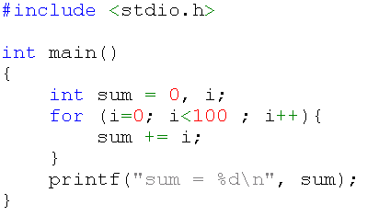
Imperative Programming
In computer science, imperative programming is a programming paradigm that describes computation in terms of statements that change a program state.

Slide 4
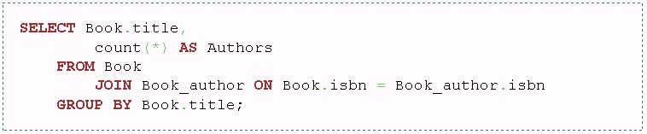
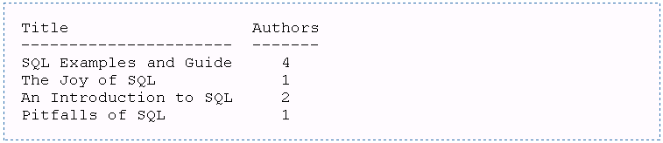
Declarative Programming
In computer science, declarative programming is a programming paradigm that expresses the logic of a computation without describing its control flow
Notes:
In computer science, declarative programming is a programming paradigm that expresses the logic of a computation without describing its control flow.[1]
In computer science, imperative programming is a programming paradigm that describes computation in terms of statements that change a program state.
The example demonstrates a query of multiple tables, grouping, and aggregation, by returning a list of books and the number of authors associated with each book

Slide 5
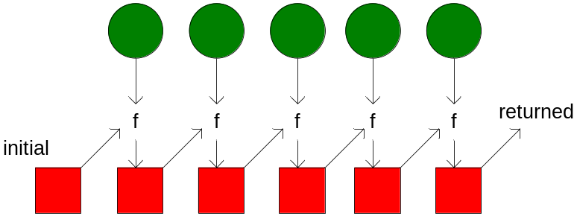
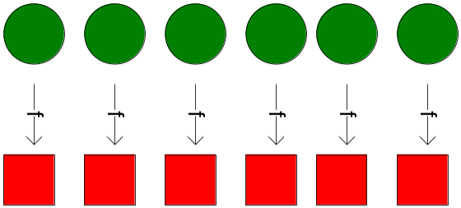
Functional Language
map f lst: (’a->’b) ->
(’a list) -> (’b list)
把f作用在输入list的每个元素上，输出一个新的list.
fold f x₀ lst: ('a*'b->'b)->
'b->('a list)->'b
把f作用在输入list的每个元素和一个累加器元素上，f返回下一个累加器的值
Notes:
Reduce ➔ foldl ：(a [a] a)

Slide 6
From Functional Language View
map f lst: (’a->’b) ->
(’a list) -> (’b list)
把f作用在输入list的每个元素上，输出一个新的list.
fold f x₀ lst: ('a*'b->'b)->
'b->('a list)->'b
把f作用在输入list的每个元素和一个累加器元素上，f返回下一个累加器的值
Functional运算不修改数据，总是产生新数据
map和reduce具有内在的并行性
  Map可以完全并行
  Reduce在f运算满足结合律时，可以乱序并发执行
Reduce ➔ foldl ：(a [a] a)
Notes:
Reduce ➔ foldl ：(a [a] a)

Slide 7
Example
fun foo(l: int list) = sum(l) + mul(l) + length(l)
fun sum(lst) = foldl (fn (x,a)=>x+a) 0 lst
fun mul(lst) = foldl (fn (x,a)=>x*a) 1 lst
fun length(lst) = foldl (fn (x,a)=>1+a) 0 lst
Notes:
程序设计时就隐式包含了数据流Functional operations do not modify data structures: They always create new ones
Original data still exists in unmodified form
Data flows are implicit in program design
Order of operations does not matter
Implicit Parallelism In map

Slide 8
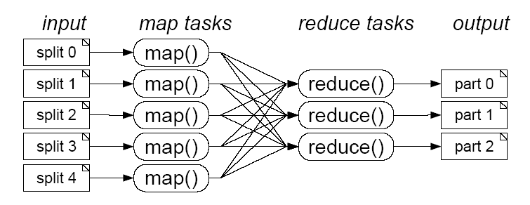
MapReduce is…
“MapReduce is a programming model and an associated implementation for processing and generating large data sets.”^{[1]}
J. Dean and S. Ghemawat, "MapReduce: Simplified Data
Processing on Large Clusters," in Osdi, 2004, pp. 137-150.
Notes:
J. Dean and S. Ghemawat, "MapReduce: Simplified Data Processing on Large Clusters," in Osdi, 2004, pp. 137-150.

Slide 9
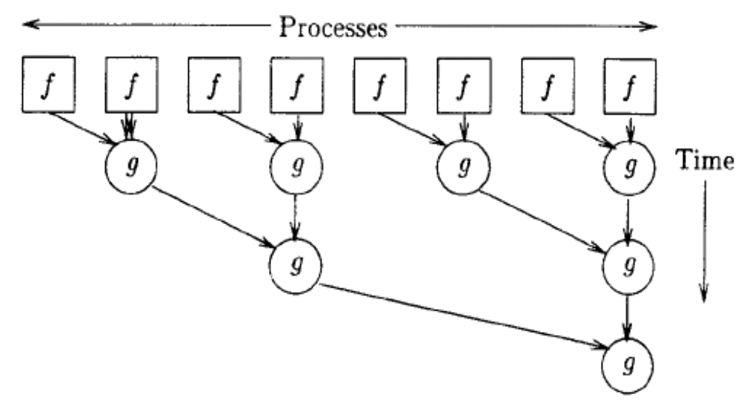
From Parallel Computing View
MapReduce是一种并行编程模型
f是一个map算子
map f (x:xs) =
f x : map f xs
g是一个reduce算子
reduce g y (x:xs) =
reduce g ( g y x) xs
homomorphic skeletons
the essence is a single function that executes in parallel on independent data sets, with outputs that are eventually combined to form a single or small number of results.
Notes:
homomorphic skeletons
同形的

Slide 10
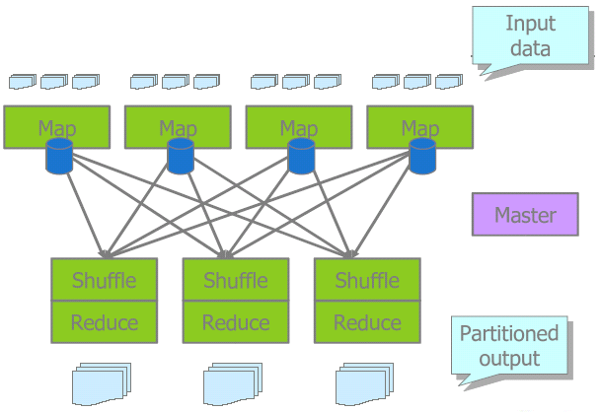
Mapreduce Framework

Slide 11
Typical problem solved by MapReduce
读入数据: key/value 对的记录格式数据
Map: 从每个记录里extract something
  map (in_key, in_value) -> list(out_key, intermediate_value)
    处理input key/value pair
    输出中间结果key/value pairs
Shuffle: 混排交换数据
  把相同key的中间结果汇集到相同节点上
Reduce: aggregate, summarize, filter, etc.
  reduce (out_key, list(intermediate_value)) -> list(out_value)
    归并某一个key的所有values，进行计算
    输出合并的计算结果 (usually just one)
输出结果
Notes:
Outline stays the same, map and reduce change to fit the problem

Slide 12
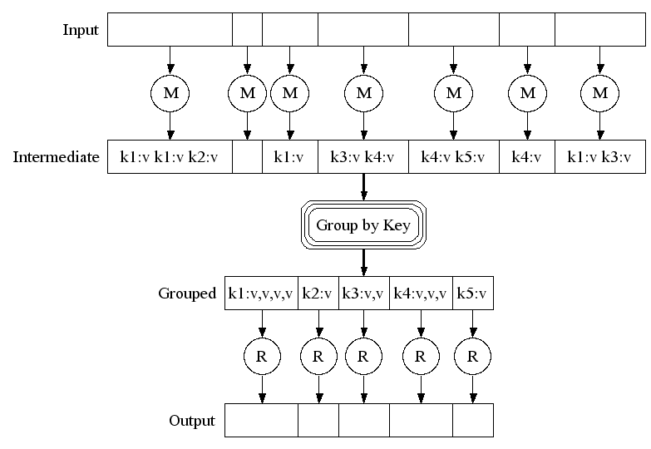
Shuffle Implementation

Slide 13
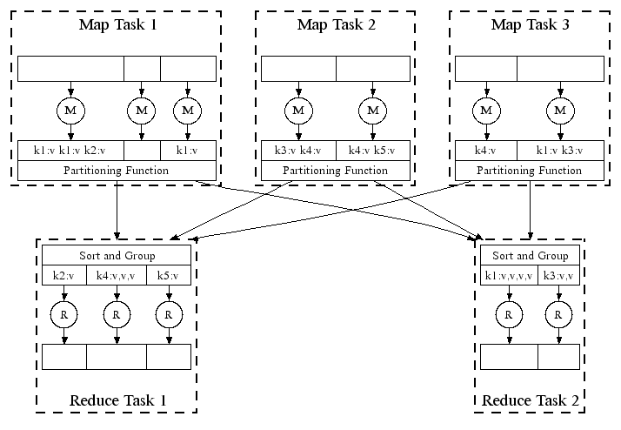
Partition and Sort Group
Partition function: hash(key)%reducer number
Group function: sort by key

Slide 14
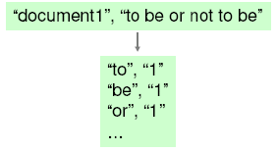
Word Frequencies in Web pages
输入：one document per record
用户实现map function，输入为
  key = document URL
  value = document contents
map输出 (potentially many) key/value pairs.
  对document中每一个出现的词，输出一个记录<word, “1”>

Slide 15
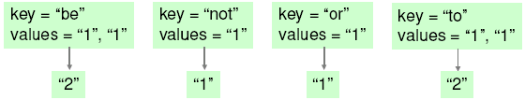

Example continued:
MapReduce运行系统(库)把所有相同key的记录收集到一起 (shuffle/sort)
用户实现reduce function对一个key对应的values计算
  求和sum
Reduce输出<key, sum>

Slide 16
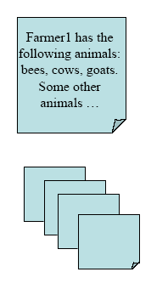
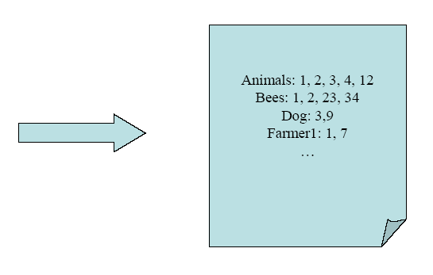
Inverted Index

Slide 17
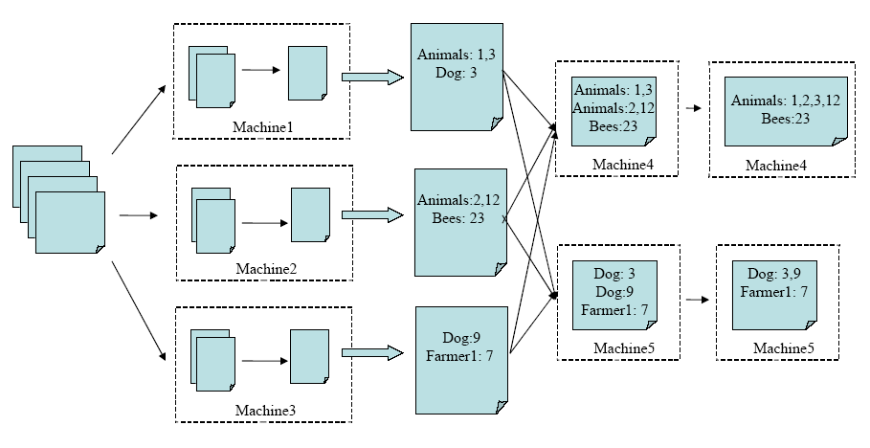





Build Inverted Index
Map: <doc#, doc_content> ➝[<word, doc#>]
Reduce: <word, [doc1, doc3, ...]> ➝ <word, “doc1, doc3, …”>

Slide 18
Build index
Input: web page data
Mapper:
  <url, document content> →<term, docid, locid>
Shuffle & Sort:
  Sort by term
Reducer:
  <term, docid, locid>* → <term, <docid,locid>*>
Result:
  Global index file, can be split by docid range
Notes:
url -> docid

Slide 19

#Exercise
PageRank Algorithm
Clustering Algorithm
Recommendation Algorithm
串行算法表述
  算法的核心公式、步骤描述和说明
  输入数据表示、核心数据结构
MapReduce下的实现：
  map, reduce如何写
  各自的输入和输出是什么

Slide 20
MapReduce Runtime System
Notes:
These are slides from Dan Weld’s class at U. Washington
(who in turn made his slides based on those by Jeff Dean, Sanjay Ghemawat, Google, Inc.)

Slide 21
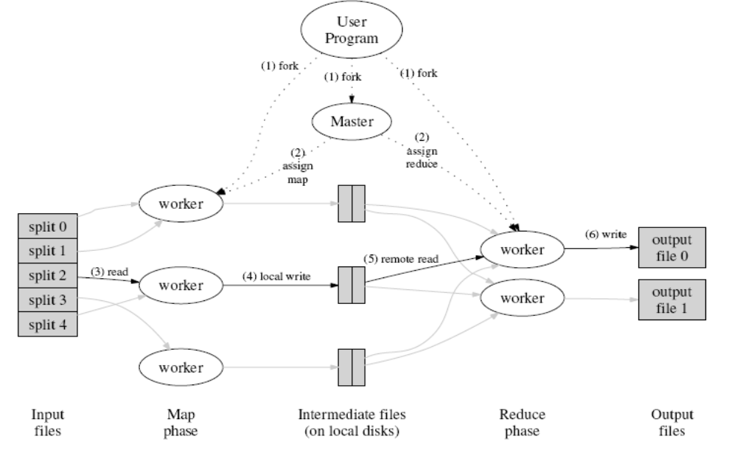

Google MapReduce Architecture
Single Master node
Many worker bees
Many worker bees
Notes:
How is this distributed?
Partition input key/value pairs into chunks, run map() tasks in parallel
After all map()s are complete, consolidate all emitted values for each unique emitted key
Now partition space of output map keys, and run reduce() in parallel
If map() or reduce() fails, reexecute!

Slide 22
MapReduce Operation
Initial data split
into 64MB blocks
Master informed of
result locations
M sends data
location to R workers
Computed, results
locally stored
Final output written

Slide 23
Fault Tolerance
通过re-execution实现fault tolerance
  周期性heartbeats检测failure
  Re-execute失效节点上已经完成+正在执行的 map tasks
    Why????
  Re-execute失效节点上正在执行的reduce tasks
  Task completion committed through master
Robust: lost 1600/1800 machines once → finished ok
Master Failure?

Slide 24
Refinement: Redundant Execution
Slow workers significantly delay completion time
  Other jobs consuming resources on machine
  Bad disks w/ soft errors transfer data slowly
Solution: Near end of phase, spawn backup tasks
  Whichever one finishes first "wins"
Dramatically shortens job completion time

Slide 25
Refinement: Locality Optimization
Master scheduling policy:
  Asks GFS for locations of replicas of input file blocks
  Map tasks typically split into 64MB (GFS block size)
  Map tasks scheduled so GFS input block replica are on same machine or same rack
Effect
  Thousands of machines read input at local disk speed
    Without this, rack switches limit read rate

Slide 26
Refinement: Skipping Bad Records
Map/Reduce functions sometimes fail for particular inputs
  Best solution is to debug & fix
    Not always possible ~ third-party source libraries
  On segmentation fault:
    Send UDP packet to master from signal handler
    Include sequence number of record being processed
  If master sees two failures for same record:
    Next worker is told to skip the record

Slide 27
Other Refinements
Compression of intermediate data
Combiner
  “Combiner” functions can run on same machine as a mapper
  Causes a mini-reduce phase to occur before the real reduce phase, to save bandwidth
Local execution for debugging/testing

Slide 28
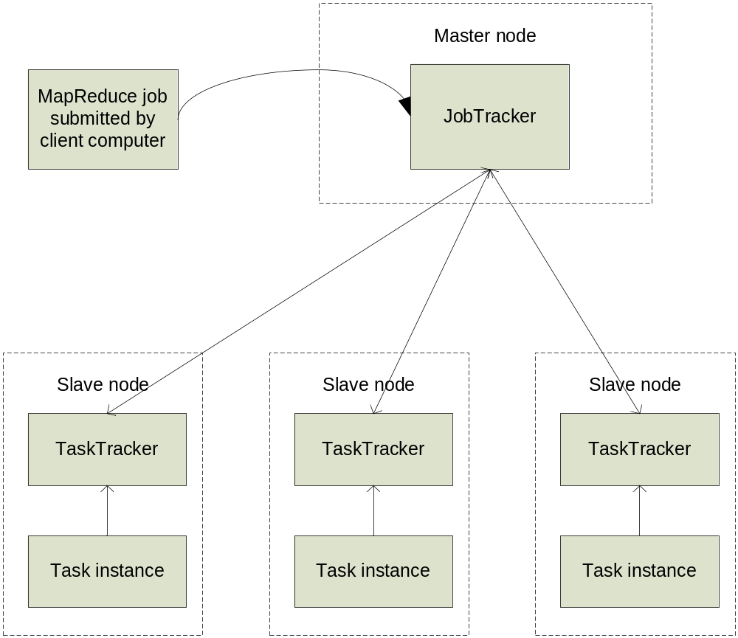

Hadoop MapReduce Architecture
Master/Worker Model
Load-balancing by polling mechanism

Slide 29
MapReduce示例程序
参见MapReduce官方网站https://hadoop.apache.org/docs/stable/hadoop-mapreduce-client/hadoop-mapreduce-client-core/MapReduceTutorial.html#Purpose

Slide 30
MapReduce不足
Shuffle：网络传输（network I/O），耗费大量的时间

Slide 31
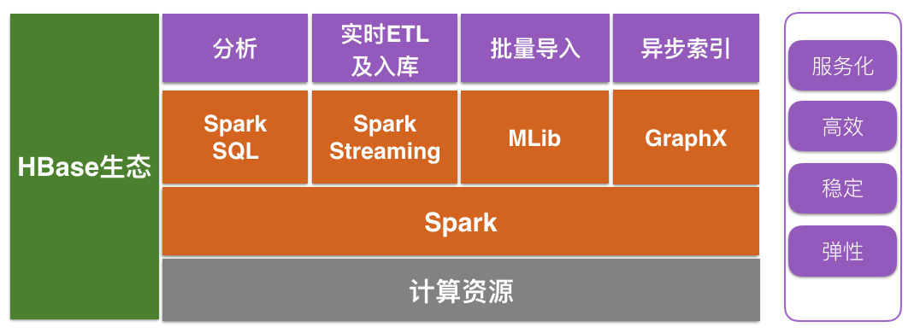
Spark

Slide 32
MapReduce与Spark区别
Spark在处理数据时构建了DAG有向无环图，减少了shuffle和数据落地磁盘的次数
如果计算不涉及与其他节点进行数据交换，Spark 可以在内存中一次性完成这些操作，也就是中间结果无须落盘，减少了磁盘 IO 的操作
spark会提前向资源管理器（yarn，mess）将资源申请完毕，如果申请不到资源就等待，如果申请到就运行task任务，而不需要task再去申请资源
MapReduce是细粒度申请资源，提交任务，task自己申请资源自己运行程序，自己释放资源

Slide 33
Spark优势
1.每一个作业独立调度，可以把所有的作业做一个图进行调度，各个作业之间相互依赖，在调度过程中一起调度，速度快。
2.所有过程都基于内存，所以通常也将Spark称作是基于内存的迭代式运算框架。
3.spark提供了更丰富的算子，让操作更方便。
4.更容易的API：支持Python，Scala和Java
  其实spark里面也可以实现Mapreduce，但是这里它并不是算法，只是提供了map阶段和reduce阶段，但是在两个阶段提供了很多算法。如Map阶段的map, flatMap, filter, keyBy，Reduce阶段的reduceByKey, sortByKey, mean, gourpBy, sort等。

Slide 34
History of Hadoop
2004 - Initial versions of what is now Hadoop Distributed File System and Map-Reduce implemented by Doug Cutting & Mike Cafarella
December 2005 - Nutch ported to the new framework. Hadoop runs reliably on 20 nodes.
January 2006 - Doug Cutting joins Yahoo!
February 2006 - Apache Hadoop project official started to support the standalone development of Map-Reduce and HDFS.
March 2006 - Formation of the Yahoo! Hadoop team
May 2006 - Yahoo sets up a Hadoop research cluster - 300 nodes
April 2006 - Sort benchmark run on 188 nodes in 47.9 hours
May 2006 - Sort benchmark run on 500 nodes in 42 hours (better hardware than April benchmark)
October 2006 - Research cluster reaches 600 Nodes
December 2006 - Sort times 20 nodes in 1.8 hrs, 100 nodes in 3.3 hrs, 500 nodes in 5.2 hrs, 900 nodes in 7.8
January 2006 - Research cluster reaches 900 node
April 2007 - Research clusters - 2 clusters of 1000 nodes
Sep 2008 - Scaling Hadoop to 4000 nodes at Yahoo!
Notes:
http://developer.yahoo.net/blog/archives/2007/07/yahoo-hadoop.html

Slide 35
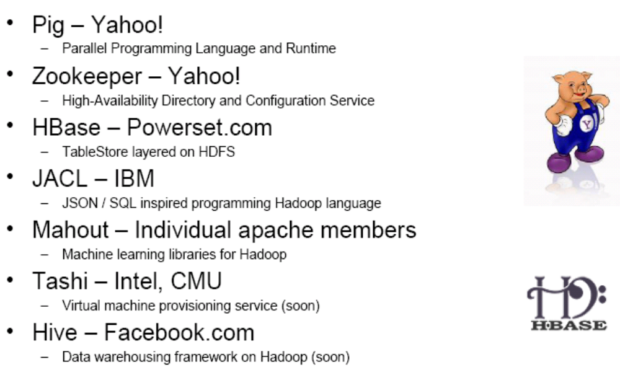
Hadoop Software Ecosystem

Slide 36
Thank You!
Q&A

Slide 37
Calculate PageRank
Input: WebGraph <from , <PR,<to>*>>
Iteration Until Convergence
  Mapper:
    <from, <PR,<to>*>> →
    <to , PR / outDegree(from)>
    <from, <PR,<to>*>> → <from, <0,<to>*>>
  Shuffle & Sort
    By <to>
  Reducer:
    <to , valude>* 以及<to, <0, <out>*> → <to, ∑(value), <out>*>
Result:
  <to, ∑(value)> are PR[]，the PageRank result array

Slide 38
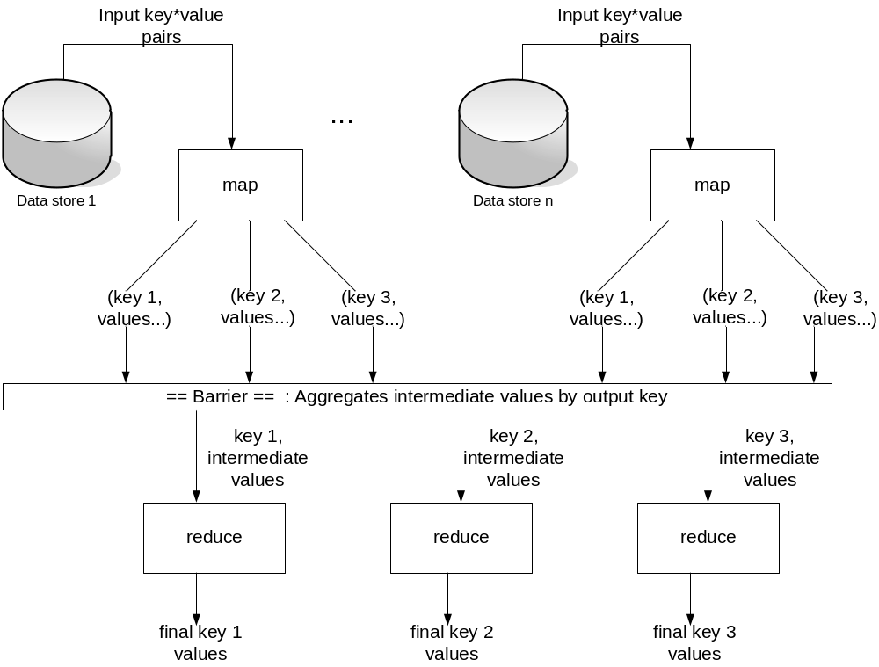
Mapreduce Framework

Slide 39
Quiz
1.使用2种不同的聚类方法将下面实例聚合为3类：
(-4,-2),(-3,-2),(-2,-2),(-1,-2),
(1,-1),(1,1),(2,3),(3,2),(3,4),(4,3)
讨论这些方法的差异，哪些方法得到了相同的结果？和人工聚类过程相比，这些结果有何不同？

Slide 40
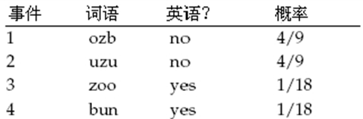
2。你的任务是将单词分成英语(English)类或非英语类。这些单词的产生来自如下分布：
(i) 计算多项式NB分类器的参数，分类器使用字母b、n、o、u和z作为特征。在计算参数时使用平滑方法，零概率平滑成0.01，而非零概率不做改变。
(ii) 上述分类器对单词zoo的分类结果是什么？

